Slide 1

AR Country Data Explorer
David Suppan, 11813815

Slide 2
Main idea
Visualize and explore data between countries with AR
Used datasets:
Austria‘s 2023 Import/Export data (https://www.statistik.at/atlas/itgs/, accessed on 14.06.2024)
Estimated migration flows 2015-2020 (https://www.bib.bund.de/DE/Fakten/Tools/Migration/Globalflows.html, accessed on 14.06.2024)

Slide 3
How AR was used
Technologies used
Unity 2022.3.14f1
AR Foundation 5.1.1
Google Pixel 8/Android 14
AR Features used
Plane Detection
Gesture Interactions (i.e. Touchscreen Taps)
Interactable Placement

Slide 4
How to interact
Users can place countries on a surface (e.g. floor, table) via taps
Users can drag countries around the area to get a good overview (select first)
Users can change and delete existing countries (floating UI buttons)
Users can choose between data categories to be visualized (fixed top right button)
Users can reset the AR session (fixed top left button)

Slide 5
Hardware requirements
Android or iOS device with a camera
For detailed platform support information visit https://docs.unity3d.com/Packages/com.unity.xr.arfoundation@6.0/manual/index.html#platform-support

Slide 6
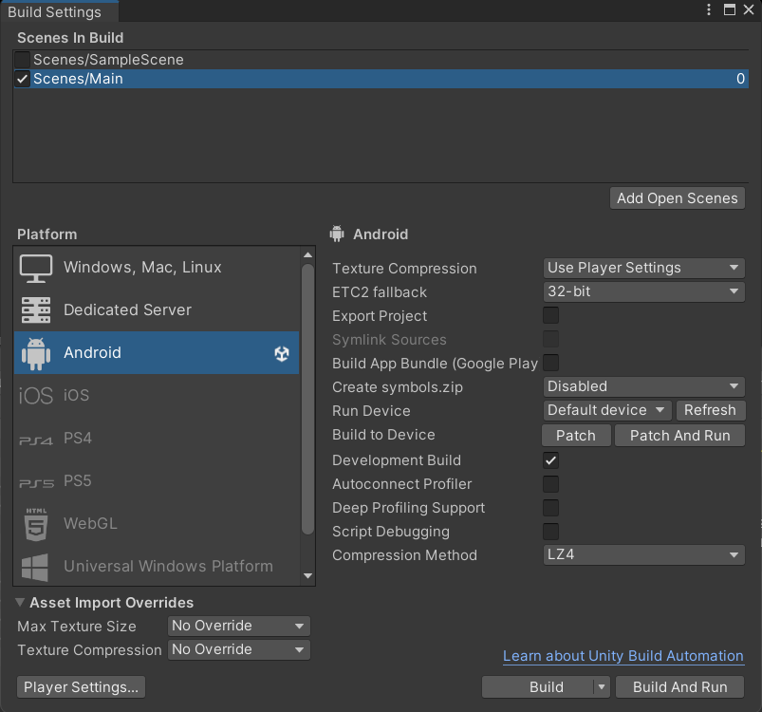
Build instructions
Open project
File → Build Settings
Select Android
Use the settings like shown in the screenshot
Connect Android phone with Debugging enabled
Click Build and Run

Slide 7
Learning outcomes
Deep understanding of AR Foundation features in Unity
Tracker-based approach was discarded due to bad detection performance
Plane detection as a good alternative
Setup can be tedious:
Android Debugging Mode
Input/Event systems
Interaction Managers
XR Package vs AR Foundation
UI is painful
Unity UI Toolkit is easier to use
Differentiating between UI taps and „AR“ taps can be difficult
Visualization of connections was tedious
Unity‘s Spline Package is not well documented and in an early stage
Logic for country connections was time-consuming to implement
Light estimation was tested but worsened the readability of the visualization → discarded

Slide 8
AR Country Data Explorer
David Suppan, 11813815

